Slide 1
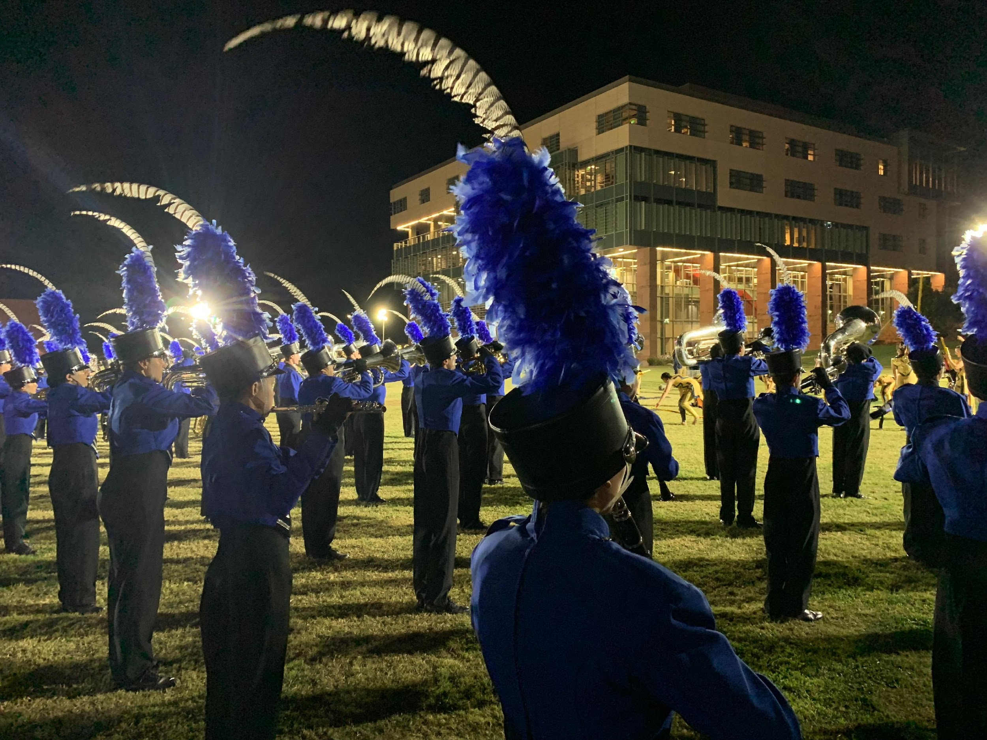
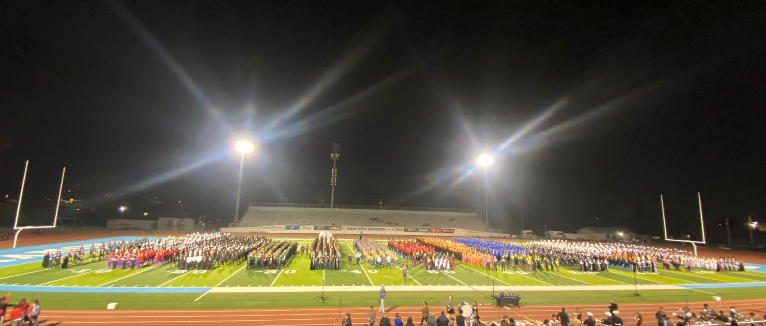

Slide 2
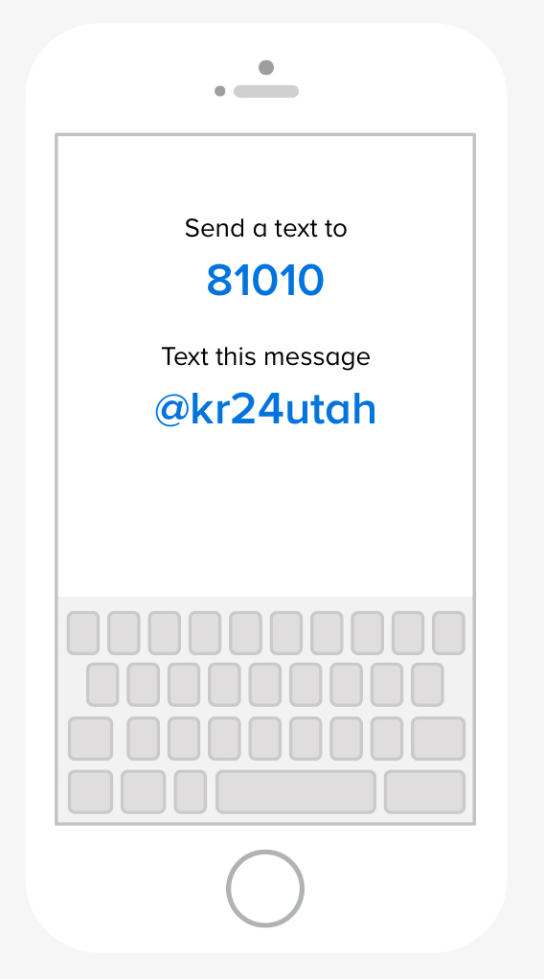
Communication from Boosters
We will be using the Remind app for both championships. To receive updates during the trip - for instance what time we perform in the finals, pictures of the show, time we will be back, etc. Download the Remind App. and send a text —>

Slide 3
BOA Regional Championships 2024
BOA California Regional Championship
BOA Utah Regional Championship
Etiwanda HS
Prelims - we perform at 1:15 pm
Finals - when we qualify we will perform sometime after 6:45 pm
Greater Zion Stadium
Prelims - we perform at 1:15 pm
Finals - when we qualify we will perform sometime after 7:30 pm

Slide 4
Etiwanda High School
Call time 8:00 am on Saturday, Nov. 2.
Return at 2:00 am (2 hours after midnight) on Sunday, Nov. 3.
Students will need to pack a lunch they can eat on the bus on the way there - students will NOT have time to purchase concessions before we perform.
Students will receive snacks after the first performance as well as before leaving to come back to SMHS.
Pizza dinner will be provided by the boosters after the preliminary competition.
Bring black practice t-shirt, black socks, reeds, etc. for the performance
Bring a sweatshirt and comfortable clothes to wear on the bus

Slide 5
BOA California Championship
What to expect:
Visit: https://marching.musicforall.org/event/california-regional-2024/
Buy tickets NOW - may sell out. Assume we will make it finals :)
Items for sale specific to the championship - items do sell out
T-shirts, Patches, Pins
Livestream available (as long as it works) to purchase from above site
Full retreat at the end of finals

Slide 6
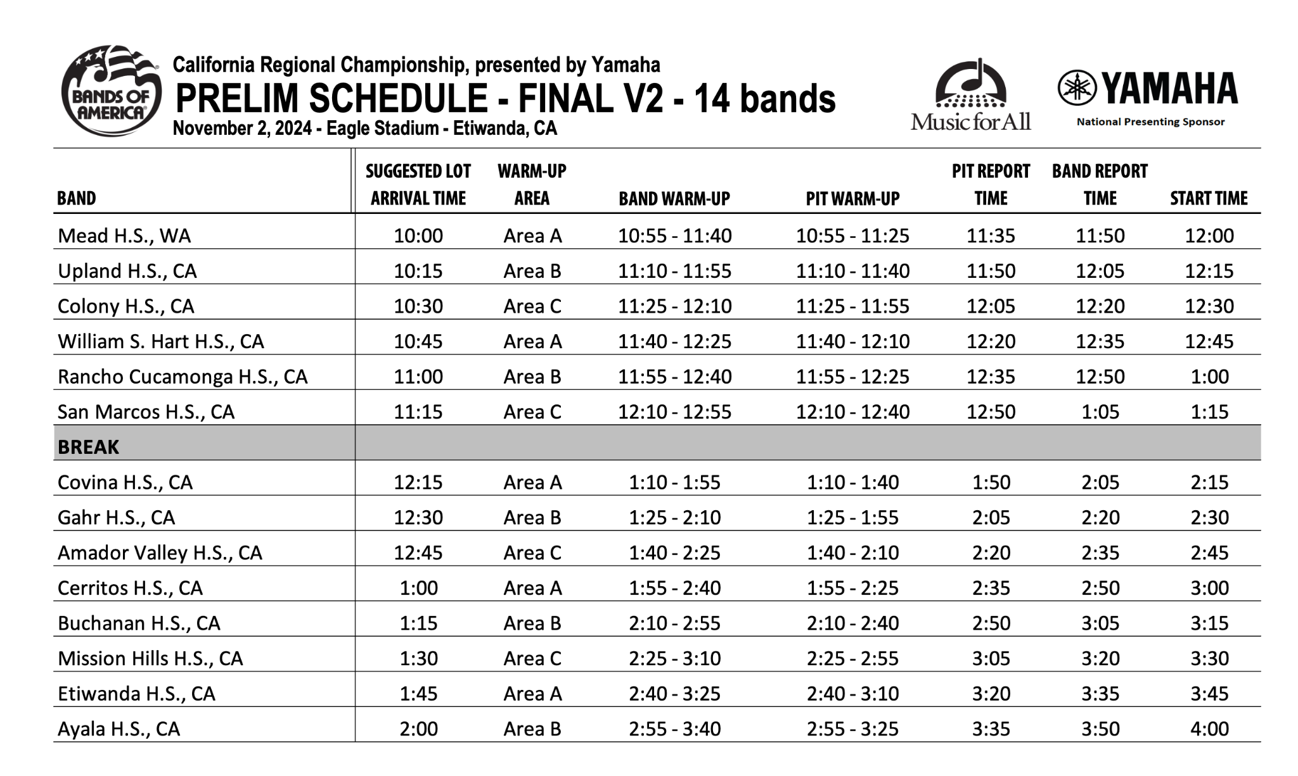

Slide 7
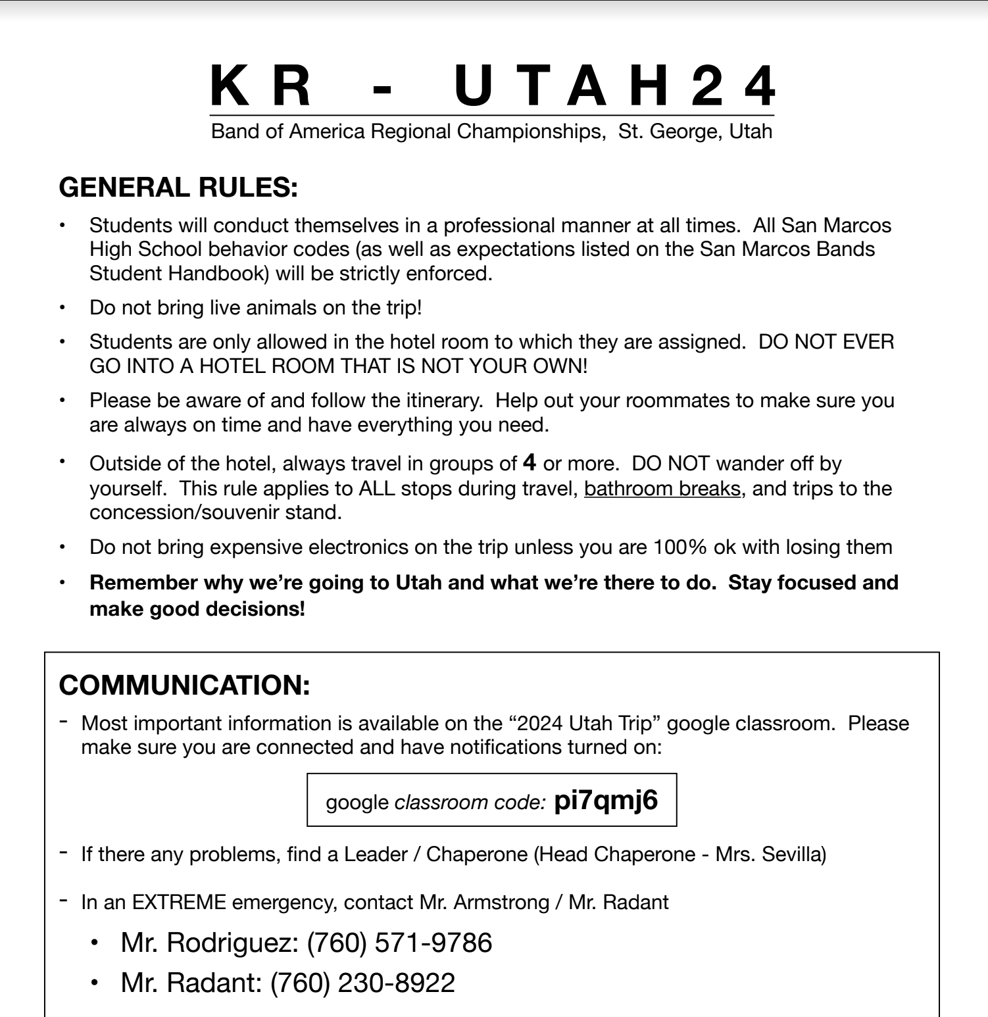
*It your student does something really, really dumb (drugs/alcohol, stealing at food/truck stops, going into rooms that they are not assigned to, etc) we will ask parents to come pick up their student from Utah. The trip is instantly over for that student and a conversation about their future in the music program will happen once we return to school.

Slide 8
St. George, UT - once in Utah all times are MDT
Friday, Nov. 8
Call time 4:15 AM
~7:15 AM Rest/Breakfast Stop - STUDENT PAY
~10:45 AM Rest/Snack Break - STUDENT PAY
~3:00 PM (MDT - 1 hour ahead of PST) Rehearse at Snow Canyon High School
~6:30 PM Arrive at hotel (Hampton Inn, 53 River Road, St. George)
~7:30 PM Eat dinner - booster provided
~10:00 PM Lights out

Slide 9
St. George, UT
Saturday, Nov. 9
Breakfast at hotel - hotel provided
11:00 AM Buses arrive at Greater Zion Stadium
1:15 PM KR PERFORMS
2:15 PM lunch - booster provided
Watch the rest of the prelim performances
5:30 PM dinner - booster provided
Finals Start

Slide 10
BOA Utah Championship
What to expect:
Visit: https://marching.musicforall.org/event/utah-regional-2024/
Buy tickets NOW - may sell out. Assume we will make it finals :)
Items for sale specific to the championship - items do sell out
T-shirts, Patches, Pins
Full retreat at the end of finals

Slide 11
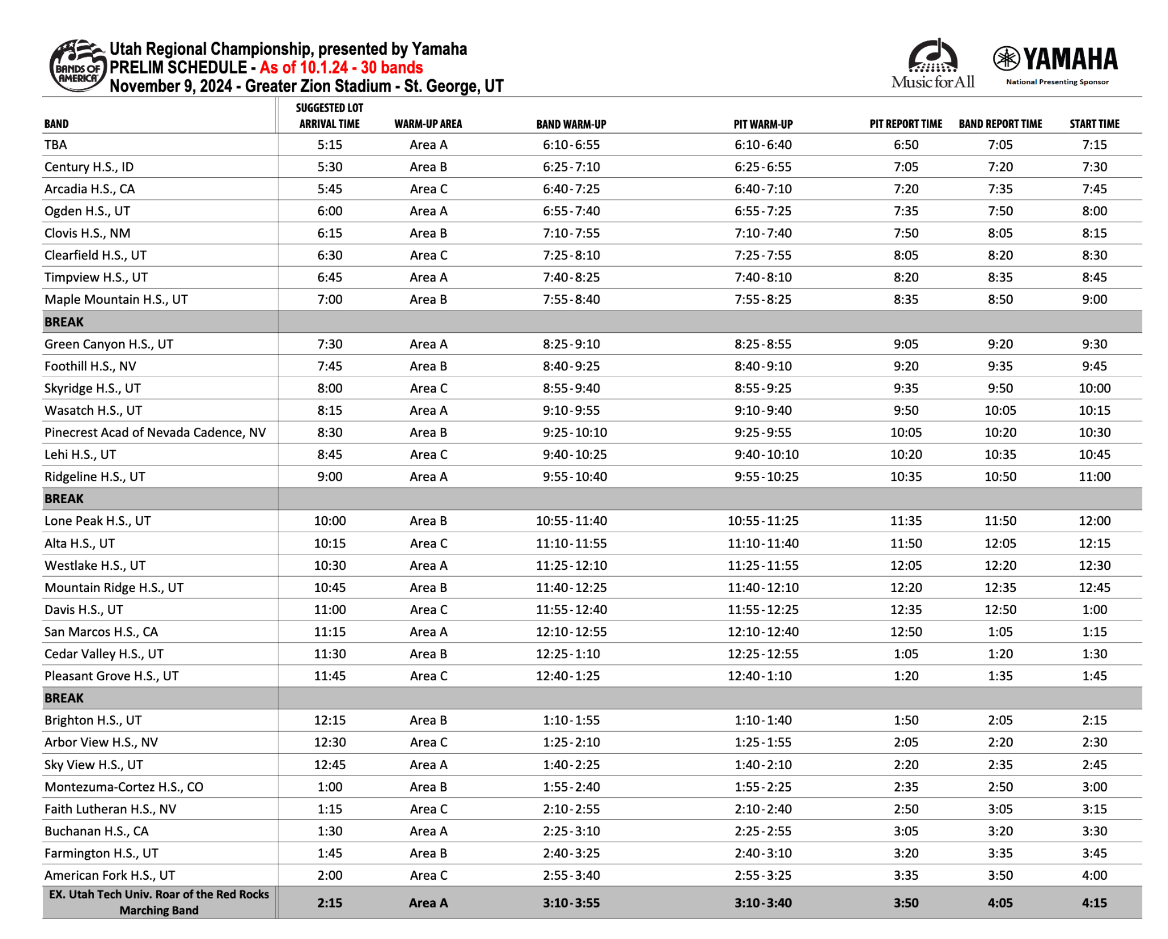

Slide 12
St. George, UT
Sunday, Nov. 10
Breakfast at hotel - hotel provided
10:00 AM Buses leave for San Marcos
~11:30 AM (PST) Rest/lunch stop - STUDENT PAY
~3:15 PM Rest/Snack stop - STUDENT PAY
~7:30 PM Student Dismissal/Parent Pick-up

Slide 13
Packing List
Wear a comfortable outfit on Friday – you will need to be able to practice in it, you will not have access to your luggage before practice. Make sure you have shoes and socks for practice and you have warm clothes for practicing in Utah on Friday afternoon.
Small bag/backpack for travel on bus: holds money, water bottle, snacks, phone, charger, things to do on long drive: book, homework
Money for Friday breakfast and lunch breaks
Money for Sunday lunch break
Water bottle
Phone Charger
Blanket for bus

Slide 14
PJs
Underwear
Socks
- socks for rehearsal
- performance socks for Saturday
Sweatshirt
Shoes for practice
Jacket
Beanie/hat for warmth
Black KR t-shirt/black long sleeve shirt
Black leggings/thermal underwear for under uniform
Comfortable outfit for Sunday
Toiletries
Medicine if needed
Deodorant (your roommates will thank you)
Toothbrush
Toothpaste
Face wash
Shampoo/conditioner
Feminine products if needed
Everything listed for Saturday and Sunday should fit in a small carry on suitcase/duffel/backpack, if it won’t fit in an overhead bin in an airplane it is too big!
DO NOT BRING gaming systems or computers – we will not be in our hotel rooms very long except for sleeping ☺

Slide 15
Go Knights!
San Marcos High School Music Boosters

Slide 16
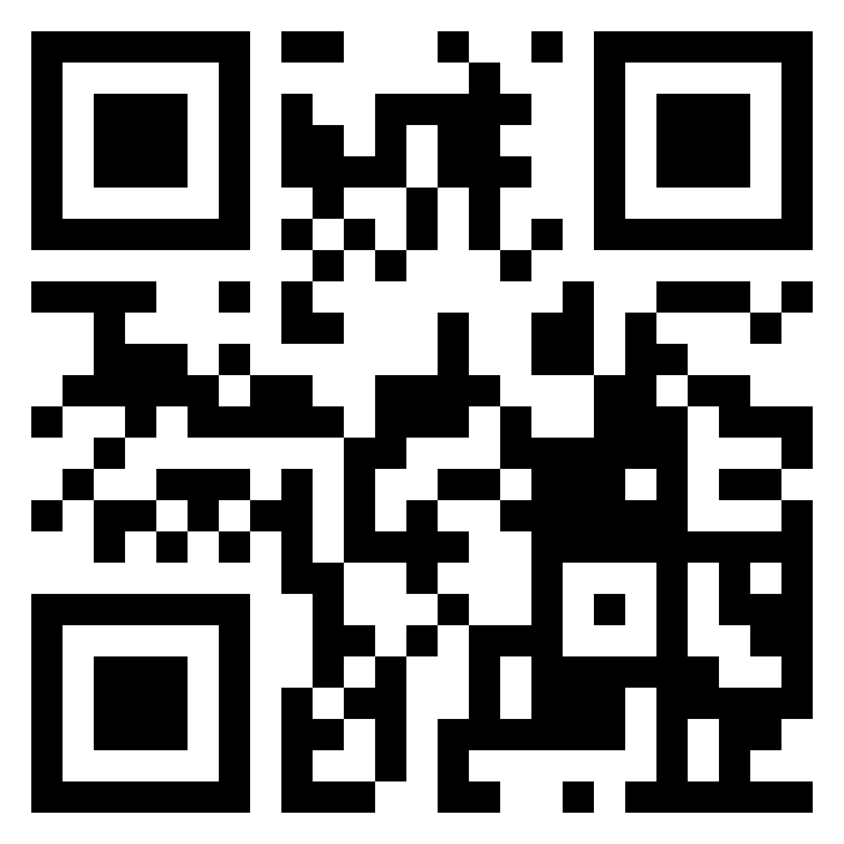
Copy of slides

